Slide 1
Mammals

Slide 2
Air as respiratory medium
Higher oxygen concentration
ventilation is easier b/c air is less dense
respiratory surface loses water to air by evaporation

Slide 3
Air as respiratory medium
Solution…
fold respiratory surface inside the body

Slide 4
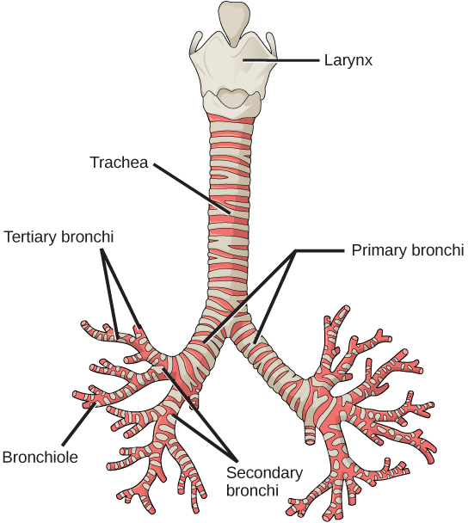
The Respiratory System
Trachea and bronchi structure
The trachea and bronchi are made of incomplete rings of cartilage.
Free to share, print, make copies and changes. Get yours at www.boundless.com
Connexions. CC BY 3.0 http://cnx.org/content/m44792/latest/Figure_39_01_07.jpg View on Boundless.com

Slide 5
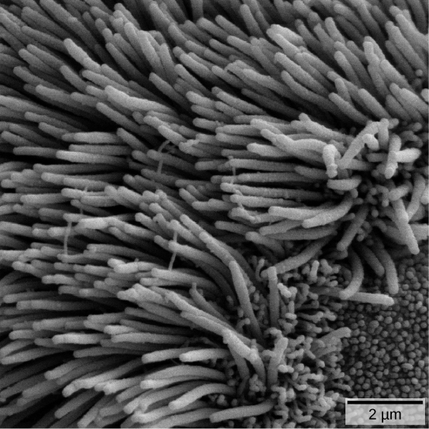
The Respiratory System
Electron microscope image of cilia
The bronchi and bronchioles contain cilia that help move mucus and other particles out of the lungs.
Free to share, print, make copies and changes. Get yours at www.boundless.com
Connexions. CC BY 3.0 http://cnx.org/content/m44792/latest/Figure_39_01_10.jpg View on Boundless.com

Slide 6
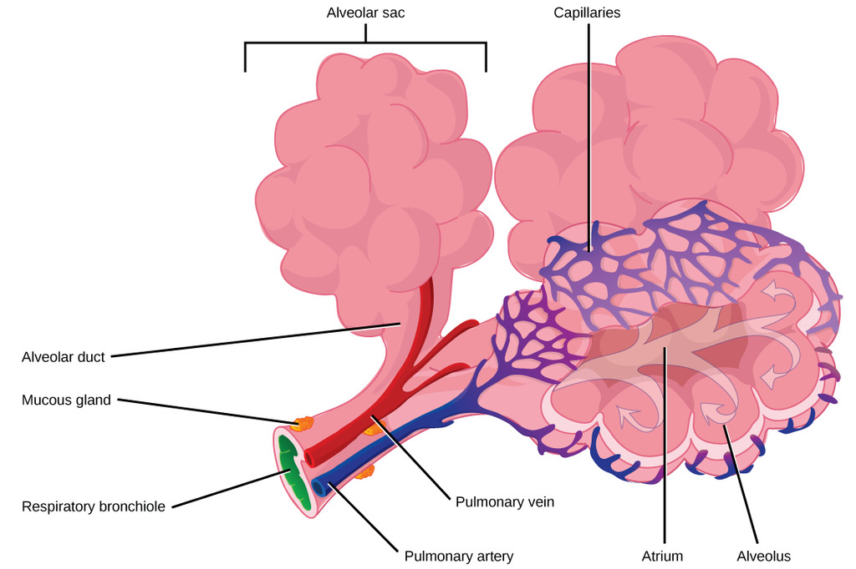
The Respiratory System
Alveolar structure
Terminal bronchioles are connected by respiratory bronchioles to alveolar ducts and alveolar sacs.Each alveolar sac contains 20 to 30 spherical alveoli and has the appearance of a bunch of grapes.Air flows into the atrium of the alveolar sac, then circulates into alveoli where gas exchange occurs with the capillaries.Mucus glands secrete mucus into the airways, keeping them moist and flexible.
Free to share, print, make copies and changes. Get yours at www.boundless.com
Connexions. "Print ." CC BY 3.0 http://cnx.org/content/m44792/latest/Figure_39_01_09.jpg View on Boundless.com

Slide 7
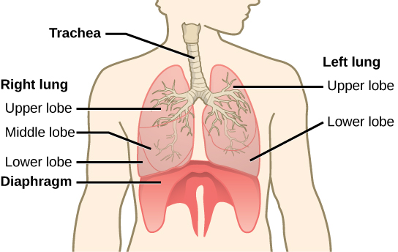
The Respiratory System
Lung structure
The trachea bifurcates into the right and left bronchi in the lungs.The larger right lung is made of three lobes.To accommodate the heart, the left lung is smaller, having only two lobes.
Free to share, print, make copies and changes. Get yours at www.boundless.com
Connexions. "Print ." CC BY 3.0 http://cnx.org/content/m44792/latest/Figure_39_01_08.jpg View on Boundless.com
Notes:
Ventilation – Negative breathing pressure in lungs

Slide 8
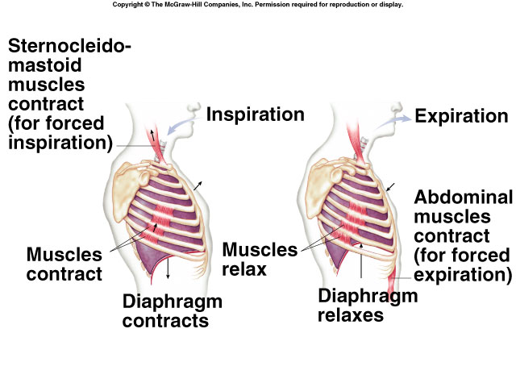
Negative pressure breathing

Slide 9
Fish

Slide 10
Disadvantages of Water for Gas Exchange
Much less oxygen compared to air
Much more energy needed to propel water because of its greater density and viscosity.
Notes:
Density – 1000x greater than air. Viscosity – 100x greater than air
10% of resting energy expenditure is accounted for in breathing compared with mammals 1-2%

Slide 11
What adaptations do fish have to counteract these disadvantages?
Water flow over the gills is unidirectional and almost continuous, so there is no dead space as there is in a lung.
The blood flows in the opposite direction to that of the water, enabling most of the oxygen to be extracted from the water.

Slide 12
Gills
most aquatic organisms
outfoldings of the body surface specialized for gas exchange
Water is the respiratory medium

Slide 13
Water as Respiratory Medium
Respiratory surface always moist
Oxygen content of water is much less than that of air
denser medium so harder to ventilate

Slide 14
Ventilation
Any method that increases the flow of the respiratory medium across the respiratory surface
This maximizes p in Fick’s Law
By constantly have new air or new water with more oxygen

Slide 15
Ventilation
requires a lot of energy to ventilate gills b/c water is denser than air
pumping operculum, ram ventilation

Slide 16
Gas Exchange Systems
Fish gill
Filaments with large area
Countercurrent flow maintains ΔP

Slide 17
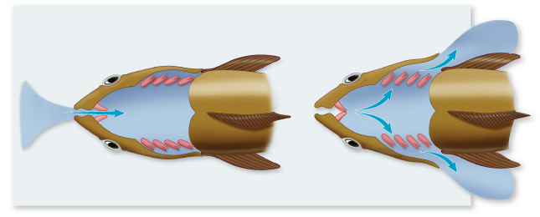
Gills
Copyright © The McGraw-Hill Companies, Inc. Permission required for reproduction or display.
Buccal cavity
Operculum
Oral valve
Water
Mouth opened,
jaw lowered
Gills
Opercular
cavity
Mouth closed,
operculum opened

Slide 18
Gas Exchange Systems
Fish gill
Countercurrent flow maintains ΔP

Slide 19
Countercurrent Exchange
Enhances gas exchange in the gills of fish
blood is continually loaded with O₂ b/c it meets water with increasing O₂ concentration
Increases p in Fick’s Law

Slide 20
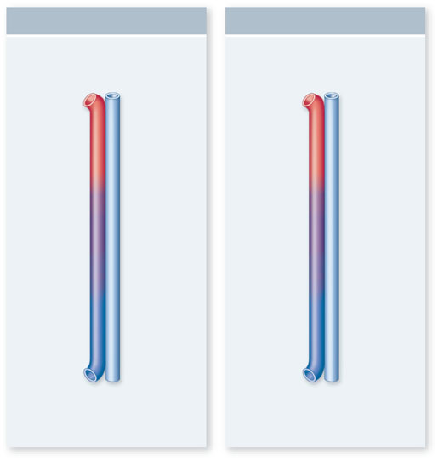
Copyright © The McGraw-Hill Companies, Inc. Permission required for reproduction or display.
Countercurrent Exchange
Concurrent Exchange
Blood (85%
O₂ saturation)
Water (100%
O₂ saturation)
Blood (50%
O₂ saturation)
Water (50%
O₂ saturation)
85%
100%
80%
90%
70%
80%
No further
net diffusion
60%
70%
50%
60%
50%
50%
40%
50%
40%
60%
30%
40%
30%
70%
20%
30%
20%
80%
10%
15%
10%
90%
Blood (0%
O₂ saturation)
Blood (0%
O₂ saturation)
Water (15%
O₂ saturation)
Water (100%
O₂ saturation)
a.
b.

Slide 21
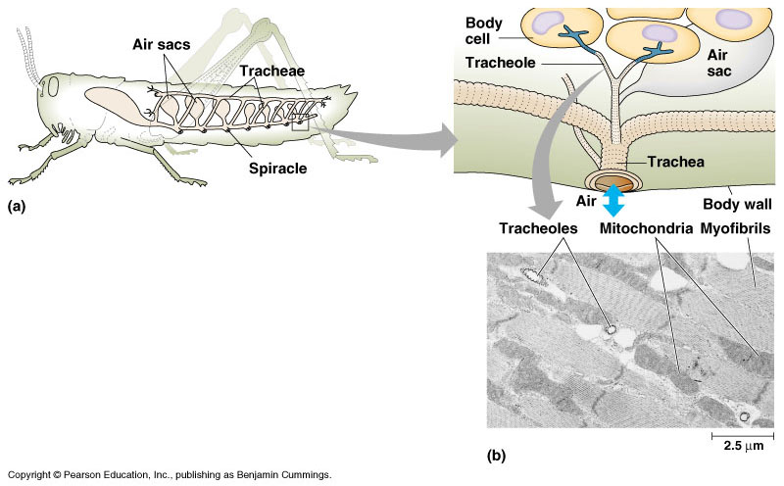
Insects

Slide 22
Trachea
Air tubes that branch throughout the body
finest tubes (tracheoles) extend to nearly every cell in the body
gas diffuses across moist epithelium that lines the terminal ends

Slide 23
Trachea
Found in insects
Open Circulatory system of insects is NOT involved in transporting gases
Ventilation
diffusion
body movements

