Slide 1
Microbe Reproduction

Slide 2
A single bacterium just before it reproduces

Slide 3
The DNA replicates (copies itself) and divides

Slide 4
Two bacteria are formed

Slide 5
Two bacteria are formed

Slide 6
Cell membrane pinches off between the two bacteria
Bacterial cells can undergo binary fission every 20minutes, provided the conditions are ideal
I.e. they have plenty of space, nutrients, water and oxygen if needed.

Slide 7
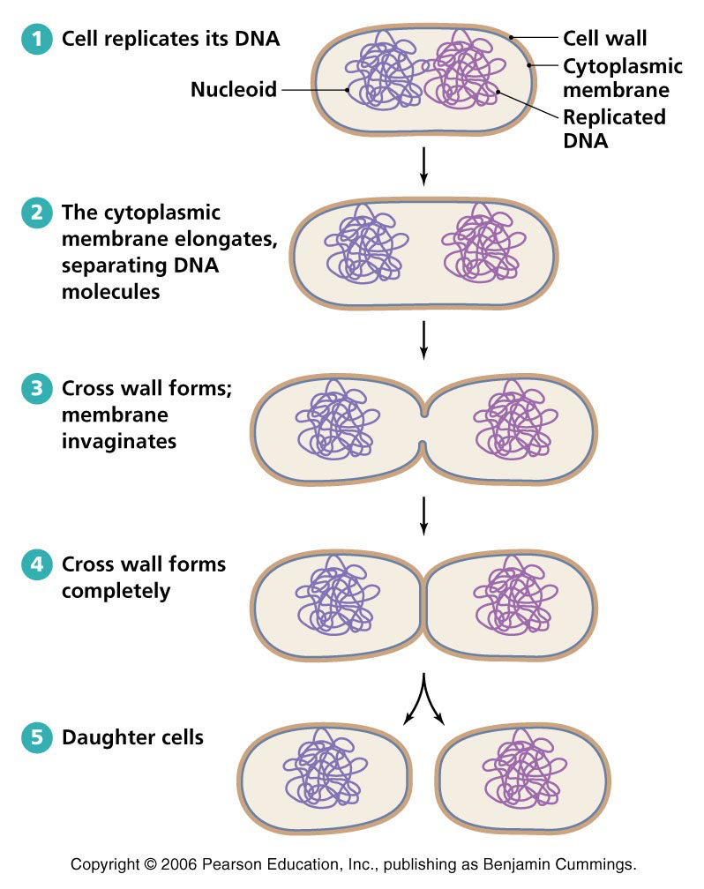

Slide 8
Virus Reproduction
Viruses reproduce by invading host cells, using the contents of the host cell to reproduce their genetic material and make new protein coats.

Slide 9
1. Virus attaches to host cell 2. Virus enters the host cell

Slide 10
3. Viral DNA is uncoated 4. Viral genetic material is replicated

Slide 11
5. New viral protein is made from the information in genetic material

Slide 12
6. New viruses are assembled and released from the host cell which often dies.

Slide 13
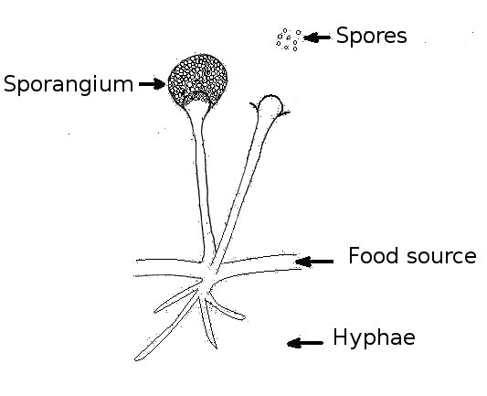
Fungal Reproduction
Hyphae – Spread through the substrate and absorb nutrients
Sporangium – Reproductive body that produces spores.
Spores – Germinate and grow into a new fungus
Fungi only reproduce if they have enough space, nutrients, oxygen (not all fungi need oxygen) and warmth (usually)

Slide 14
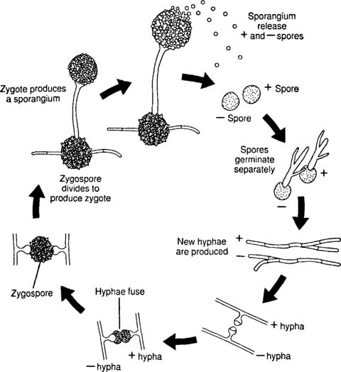
Fungal Reproduction

