Slide 1
Ecology Notes

Slide 2
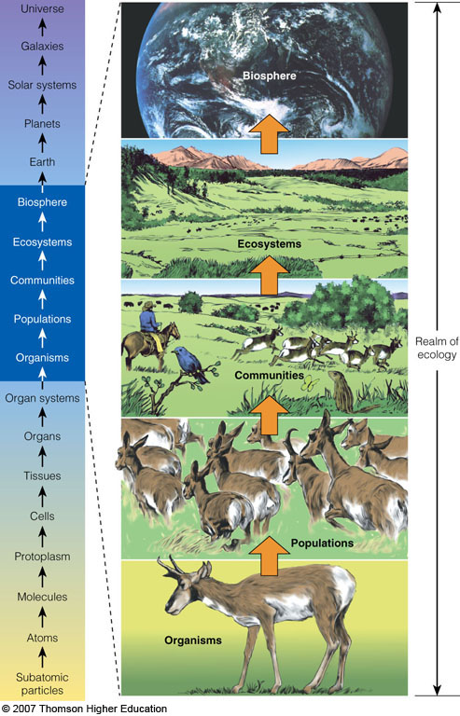
What is ECOLOGY?
Ecology is a study of connections in nature.
  How organisms interact with one another and with their nonliving environment.
Figure 3-2

Slide 3
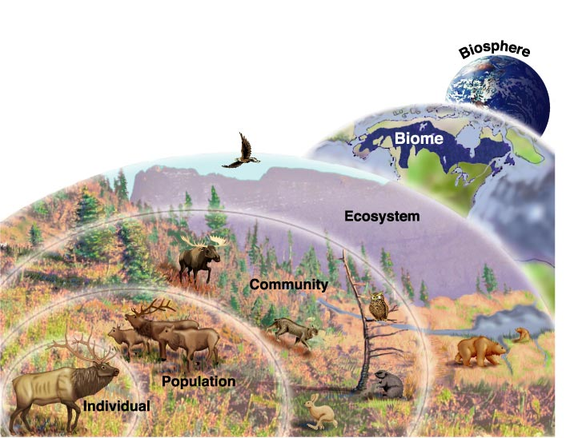
Levels of Organization

Slide 4
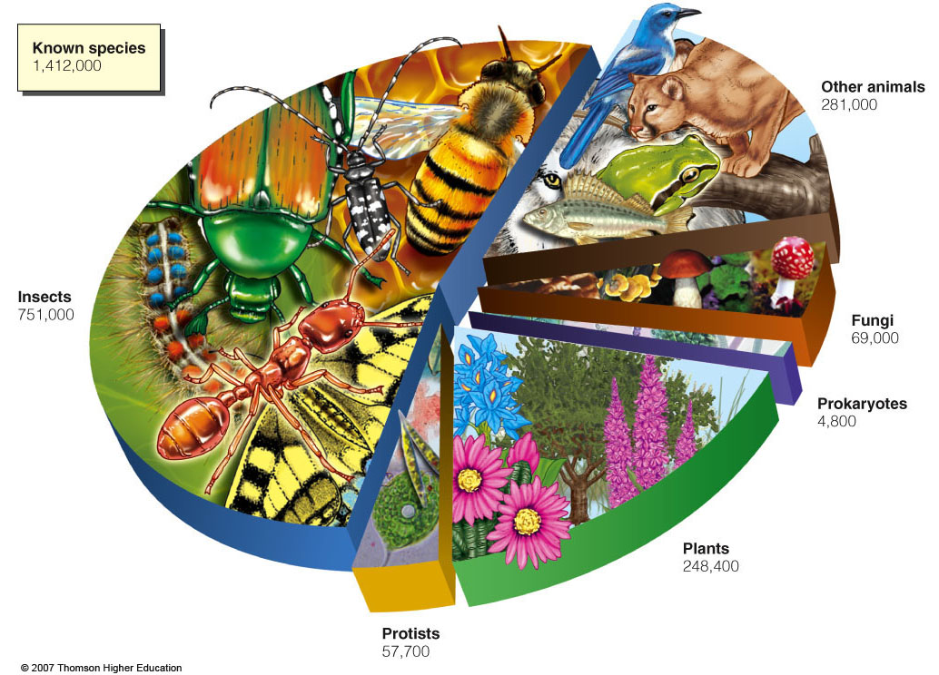
Organisms
  The different forms of life on earth
Species
  Organisms that can breed & produce fertile offspring

Slide 5
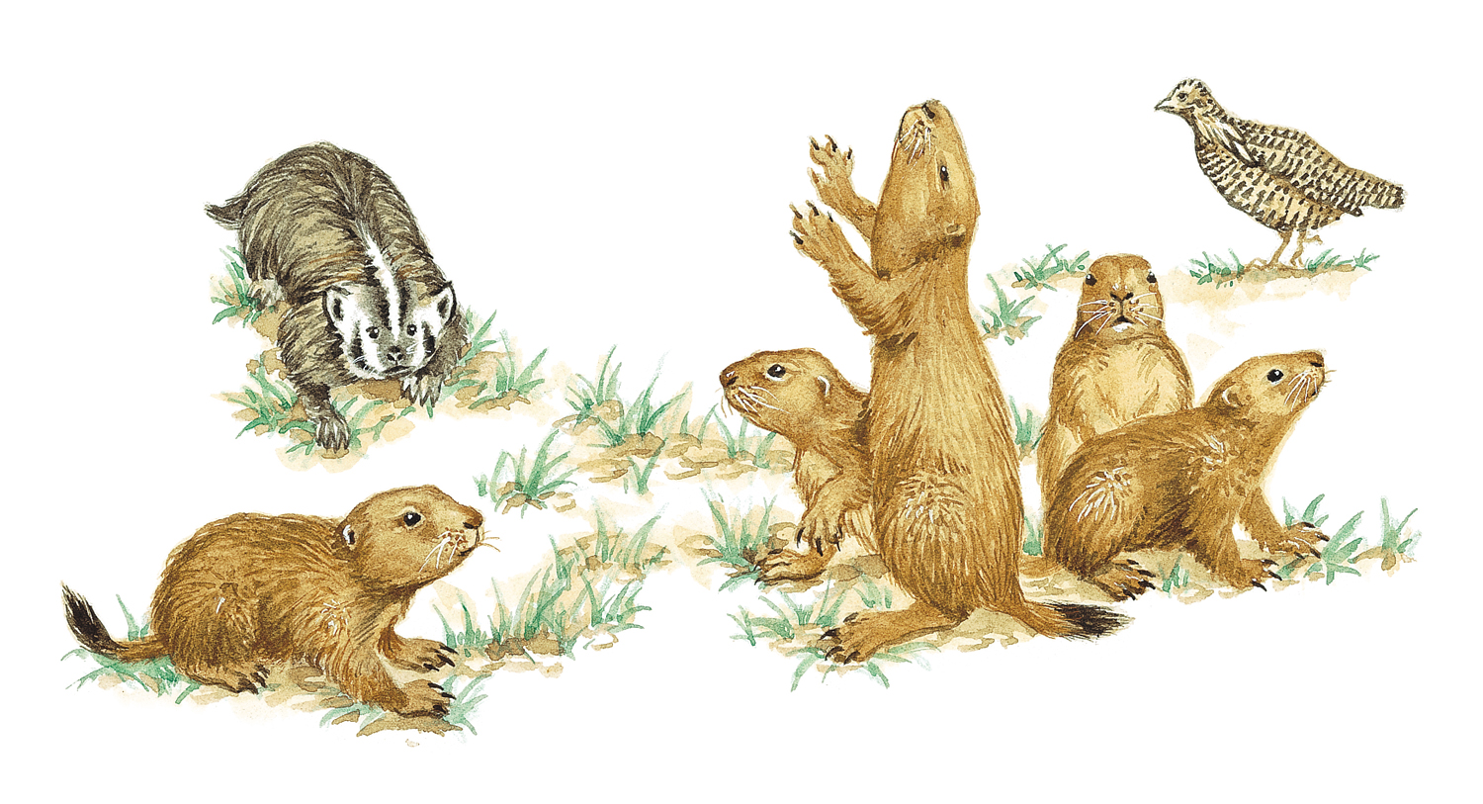
Community
Different populations that live & interact in an area.

Slide 6
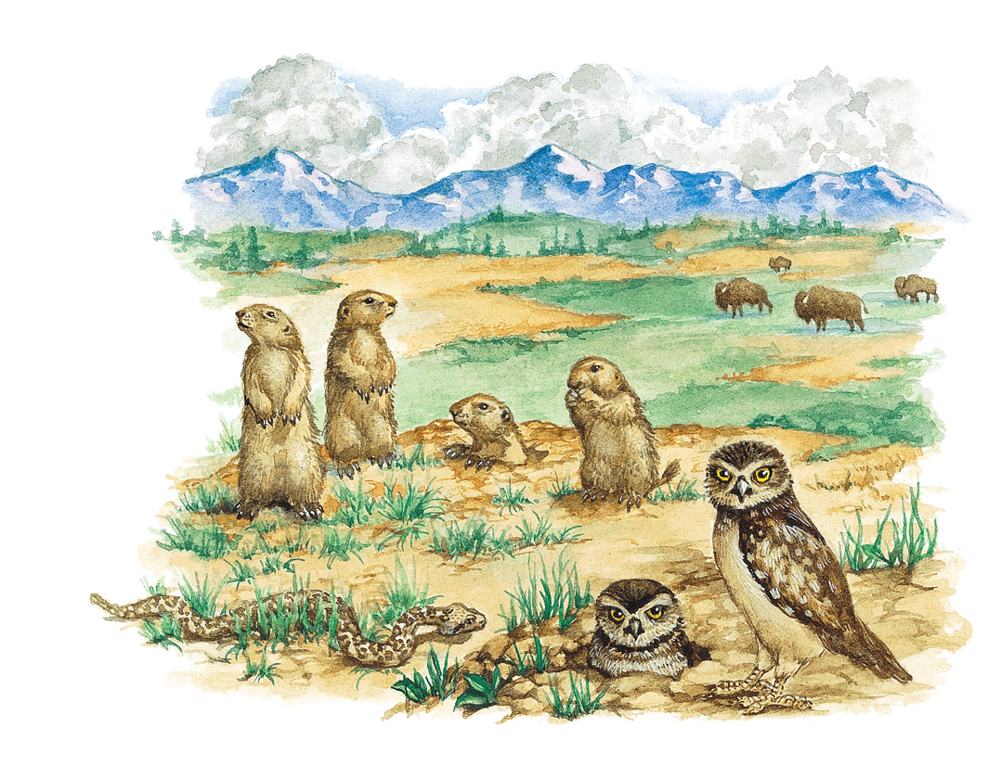
Ecosystem
The community plus their non-living environment.

Slide 7
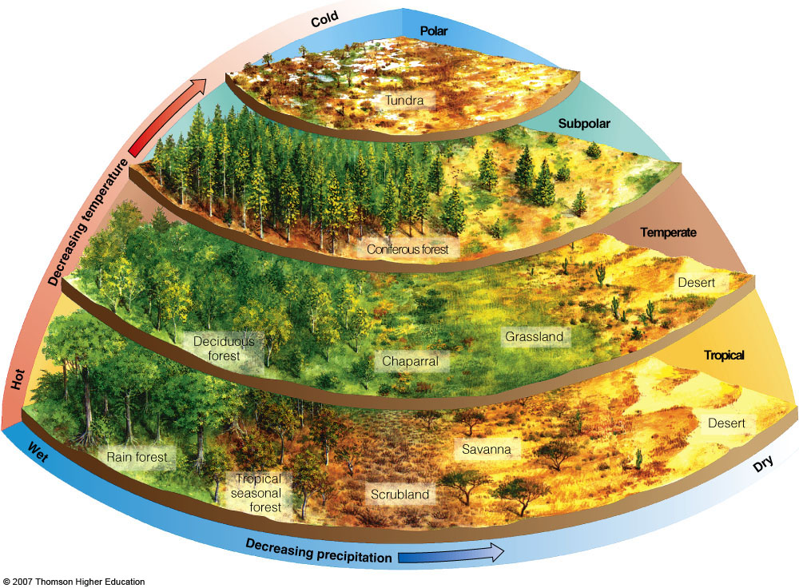
Biome
A group of ecosystems that have the same climate
  Ex. – Tundra, Taiga, Desert, Tropical Rainforest

Slide 8
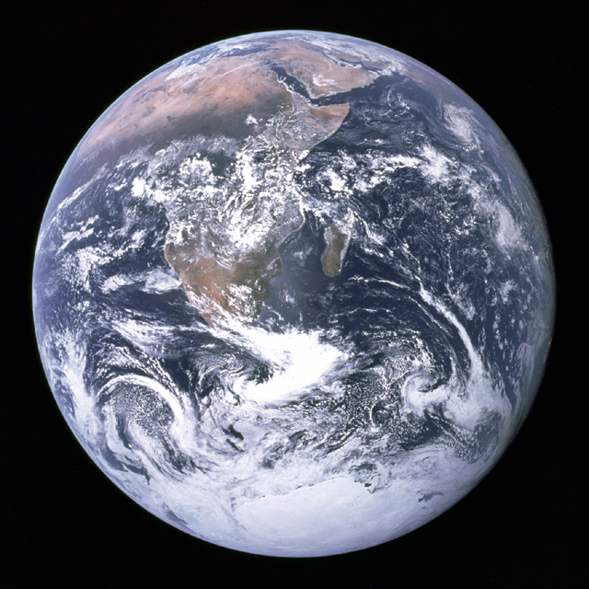
Biosphere
All of the combined portions of the planet where life exists, including land, water, and atmosphere

Slide 9
Ecosystem
The community plus their non-living environment.

Slide 10
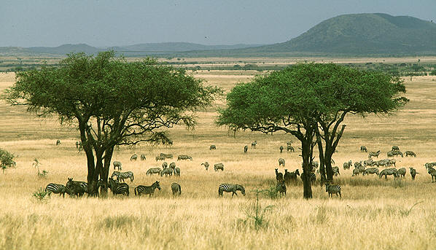
Biotic & Abiotic Factors of Ecosystems
Biotic (living)
  Ex. – bacteria, animals, plants
Abiotic (non-living)
  Ex. – humidity, solar energy, rocks, clouds

Slide 11
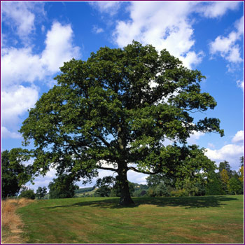
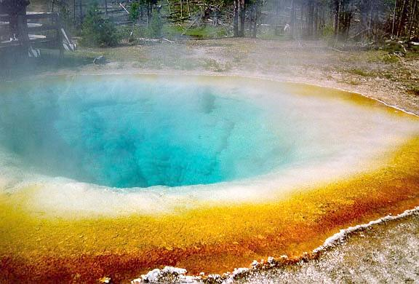
Energy Flow → Producers
Autotrophs - use solar energy or chemical energy to make their own food
Chemosynthesis
Photosynthesis
Notes:
Chemosynthesis is the biological conversion of one or more carbon molecules and nutrients into organic matter using the oxidation of inorganic molecules as a source of energy, rather than sunlight, as in photosynthesis.

Slide 12
Energy Flow →Consumers
Heterotrophs - get energy from the food they eat
  Herbivores – eats plants
  Carnivores – eats animals (includes insects)
  Omnivores – eats plants and animals
  Detritovores – feed on dead matter (scavengers)
  Decomposers – break down dead matter

Slide 13
Break it Down
Auto – self
Troph – feeding
Photo – light
Synthesis – make
Hetero – different
-vore – eat
Herb – plant
Carni – meat
Omni – all

Slide 14
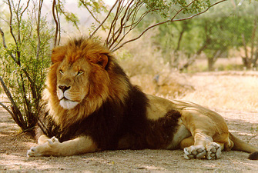
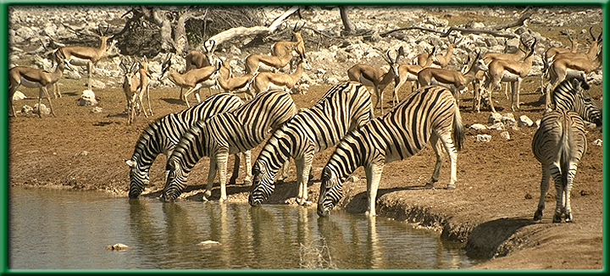
Interactions in an Ecosystem → Relationships
Predation – one organism captures and feeds on another

Slide 15
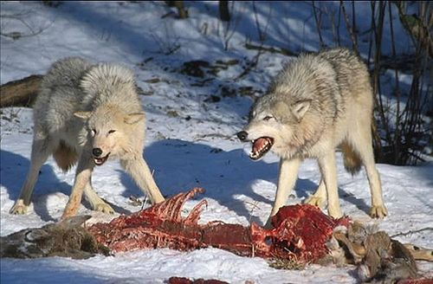
Interactions in an Ecosystem → Relationships
Competition – organisms of the same or different species attempt to use the same resources at the same time

Slide 16
Interactions in an Ecosystem → Relationships
Symbiosis – any relationship in which 2 species live closely together
  Mutualism
  Commensalism
  Parasitism

Slide 17
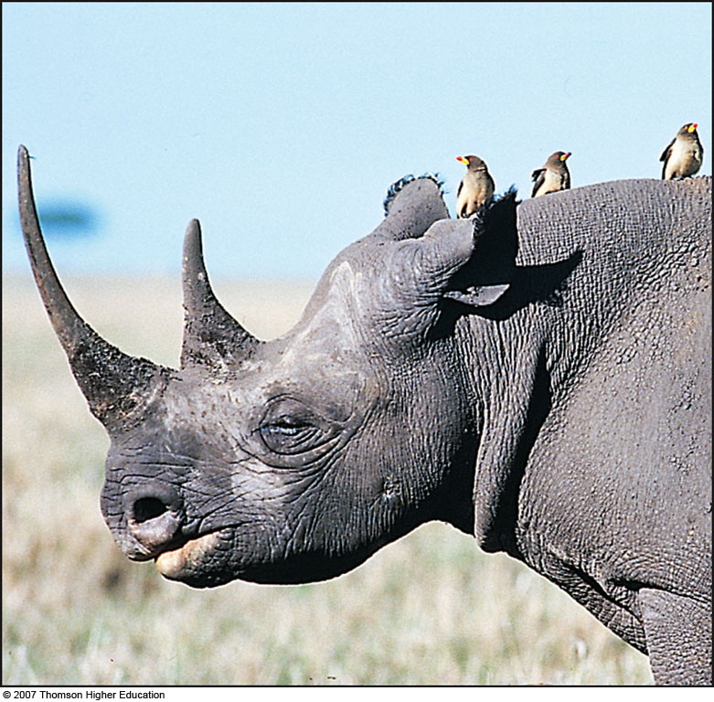
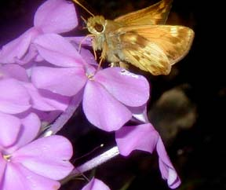
Mutualism: Win-Win Relationship
Both of them benefit
Pollination of flowers by insects
Oxpeckers and black rhinoceros

Slide 18
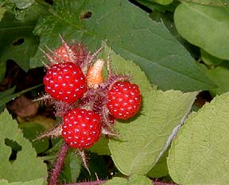
Commensalism: Using without harming
One is helped and has little or no effect on the other
Burrs are carried by animals. This helps scatter the seeds for the parent plant.

Slide 19
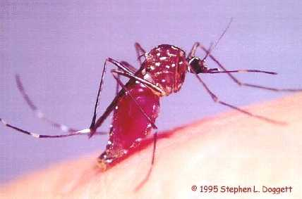
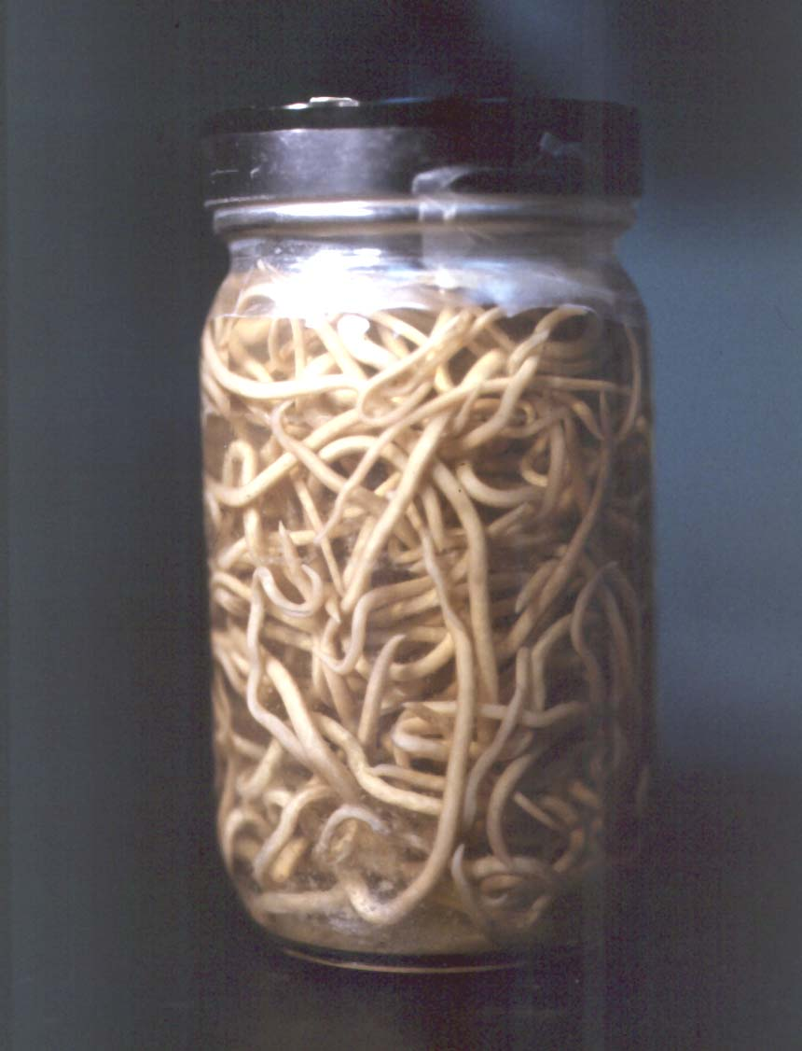
Parasitism: Sponging Off of Others
One benefits and the other is harmed
Mosquitos
Tapeworms

Slide 20
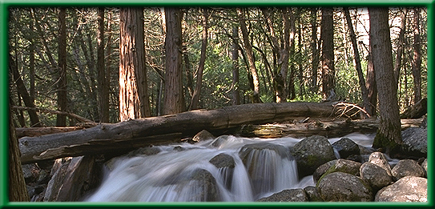
Interactions in an Ecosystem
Habitat – The area where an organism or a population lives

Slide 21
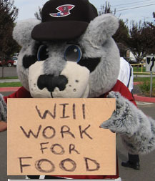
Interactions in an Ecosystem
Niche - the total role of a species in an ecosystem
  All the physical and biological conditions a species needs to live & reproduce in an ecosystem

