Slide 1
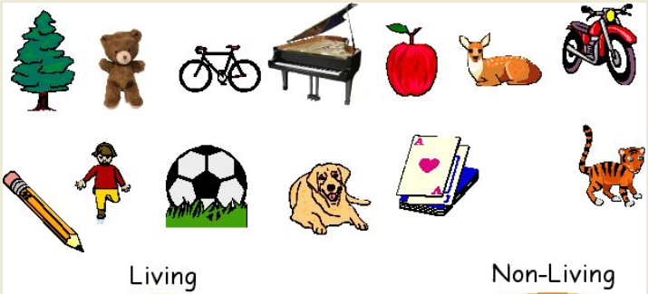

Slide 2
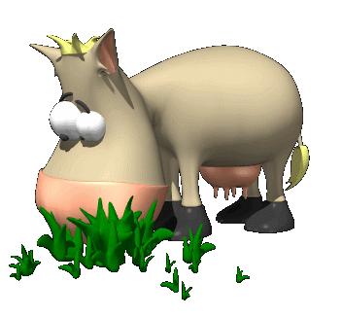
Living Things
What do all living things have in common?

Slide 3

Life Functions
Movement
Respiration
Sense
Growth
Reproduction
Excretion
Nutrition

Slide 4


Movement
Most single-celled organisms and animals move about as a whole.
Fungi and plants move parts of their bodies.
Notes:
Humans – use of bones. Joints & muscles
Plants – move leaves toward sunlight – to be able to produce more food

Slide 5
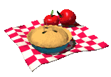

Respiration
Breaking down food to release energy for the body to use.
Most organisms need oxygen for this.
Anaerobic respiration – without oxygen
Aerobic respiration – with oxygen
Notes:
Chemical process – with or with out O2
Lungs remove O2 from air and transport around body to cells
Cells need energy – chemical reaction O2 + food gives energy and waste products (CO2 & water)

Slide 6
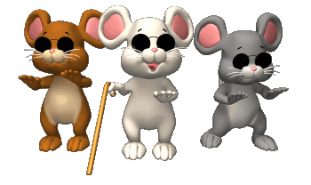
Sense
Organisms will sense and respond to changes in their surroundings.
Notes:
You are aware of what is going on inside and out side of you
Human senses – feel, touch, see, hear, taste

Slide 7
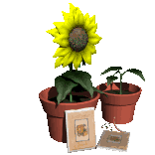
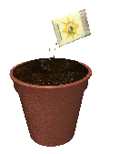
Grow
Organisms increase in size.
Most increase the number of cells in their bodies.
Notes:
All things want to grow!

Slide 8

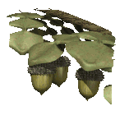
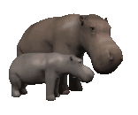
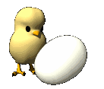
Reproduction
Single-celled organisms and bacteria may simply keep dividing into two.
Multi-celled organisms may produce sexually or non-sexually.
Notes:
Reproduce to continue on their species

Slide 9
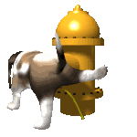
Excretion
Chemical reactions in the body produce waste products such as carbon dioxide.
Living organisms expel these substances from their bodies in various ways.
Notes:
Not just poo – poo is just undigested food
Plants – shed their leaves in Autumn
Humans – kidneys where chemicals extracted from body mixed with water to create unrine – stored in bladder, contains urea & salts
Sweating & breathing out Co2

Slide 10
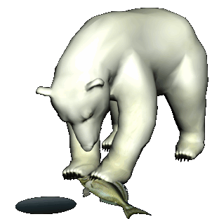
Nutrition
Food is needed for:
growth
replacement of cells
energy needed to carry out chemical processes in the body.

Slide 11
Living or Non-living
– Internet Quiz

Slide 12
Characteristics of living things
QUIZ

Slide 17
Glucose + oxygen Carbon dioxide + water
ENERGY RELEASED !!!!!!

Slide 20
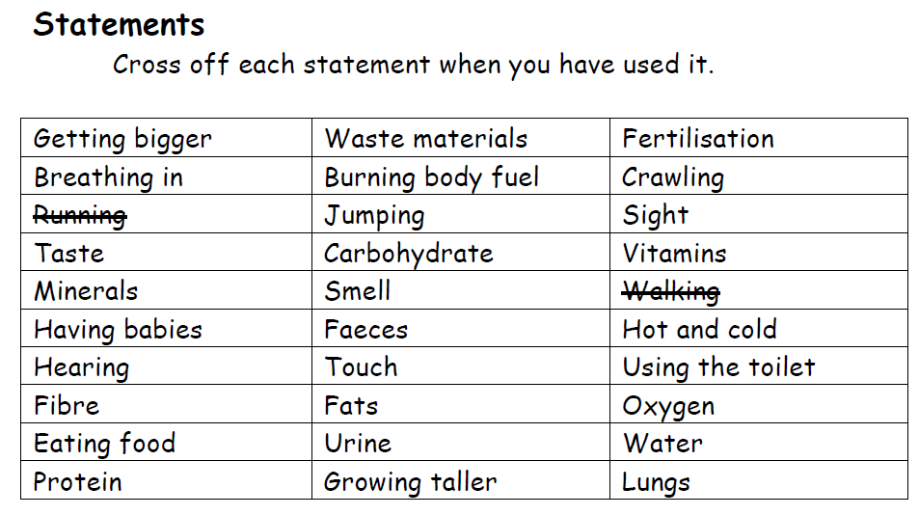
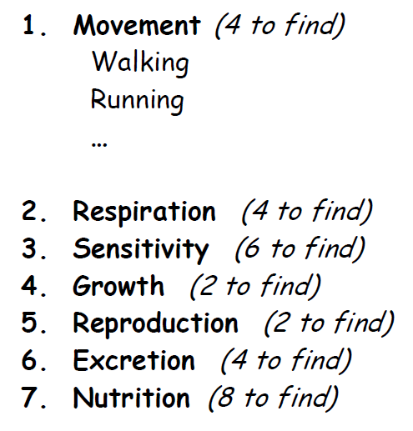

Slide 21
Match each sentence below with the characteristic which best fits it
M
Livingstone daisies open out in bright sunlight and close up when it is dark
Plants produce carbon dioxide gas in the dark
The water in an unused swimming pool gets steadily greener due to algae
A plant placed near a window will lean towards the light
Lichen growing on gravestones slowly dissolves away the rock
A coffee table made from a cross section of a tree has a circular pattern on it
Leaves contain starch
E
R
S or M
G
N
MRS GREN

Slide 22
