Slide 1
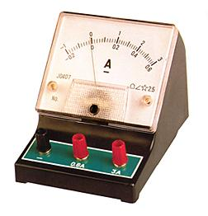
Current
Current measures the number of electrons passing a given point each second
We can measure the amount of current using an Ammeter.
A
Current is measured in Amperes (A)

Slide 2
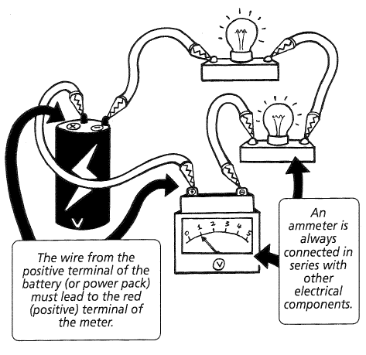
In Series
Notes:
----- Meeting Notes (9/02/15 11:00) -----
callum , patrick, brody,

Slide 3
Voltage
Voltage is a measure of how much energy is carried or provided by the electrons.
It is also called the electrical potential difference
Voltage is measured in Volts (V) , using a Voltmeter.
V

Slide 4
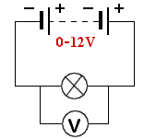
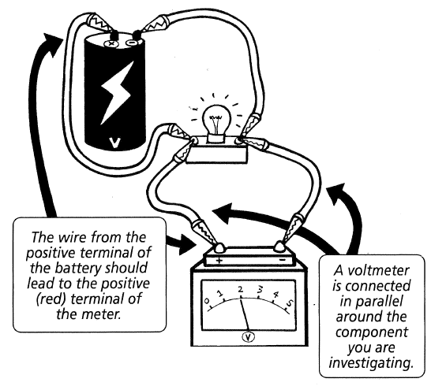
In Parallel

Slide 5
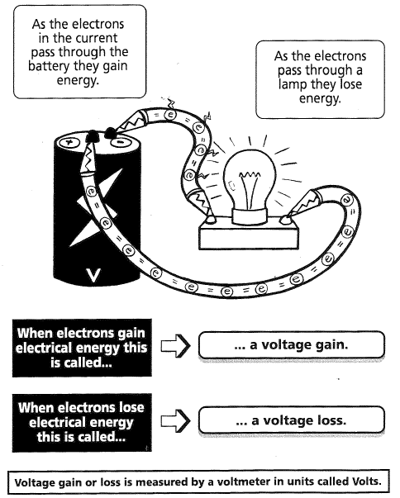

Slide 6
Resistance
The electrical resistance of an object is a measure of its opposition to the flow of electric current.
Resistance is measured in Ohms (Ω)
Electrical energy is required to push current through the resistor. This electrical energy is dissipated, heating the resistor in the process.
A resistor can also convert electrical energy into: Light, Mechanical and Sound energy

Slide 7
Conductors and Resistance
Conductivity is related to resistance
Materials that are good conductors have a low resistance.
Materials that are good insulators have a high resistance.

Slide 8
Quantities - Symbols & units
Quantity | Symbol | Unit | Symbol
Current | I | Amperes | A
Voltage | V | Volts | V
Resistance | R | Ohms | Ω

Slide 9
Rules for Series & Parallel Circuits
Series
The current is the same throughout the circuit.
The voltages across each component, add to give the total voltage.
Parallel
The currents through each branch of the circuit add to give the total current.
The voltage across each branch of the circuit is the same.

Slide 10
Ohm’s Law

