Slide 1
Moneran
Cells are the structural and functional units of all living organisms
Protist
Bacteria consist of a single cell
What is a
Cell?
cell stores their own instructions for carrying out each of these activities
Humans multicellular, or have many cells —an estimated 100,000,000,000,000 cells!
Cells can take in nutrients and convert into energy, carry out specialized functions, and reproduce…

Slide 2
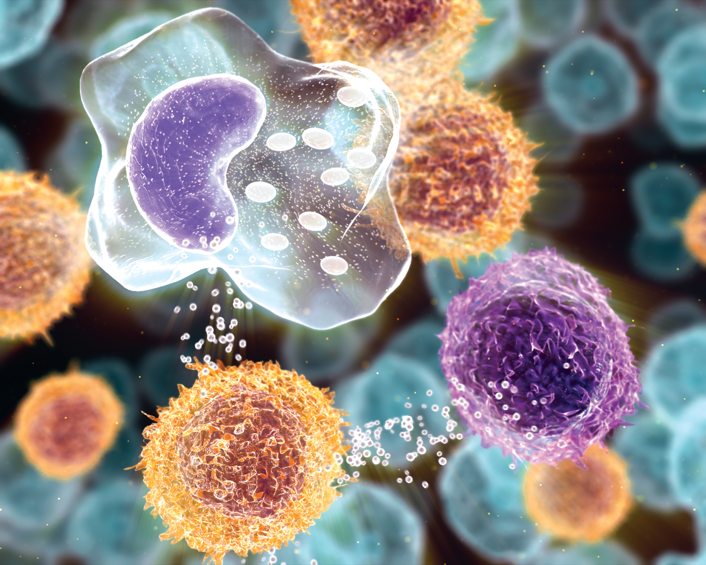
Cells SPLAT!!

Slide 3
Heart
Lungs
Liver
Organs
Stomach
Breathing
System
Kidneys
Tissue
Cytoplasm
Digestive
System
Small
Intestine
Membrane
Circulatory
System
Nervous
System
Microscope
Chloroplasts
Cell Wall
Nucleus
Vacuole

Slide 4
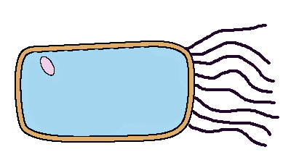
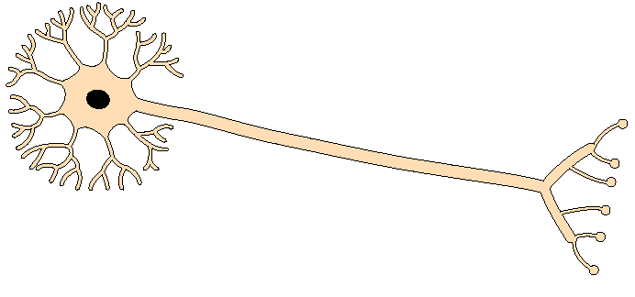
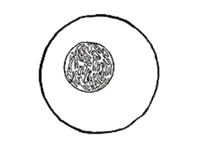
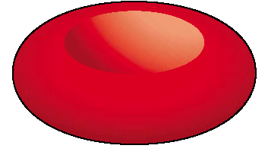
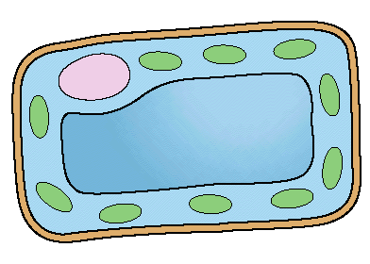
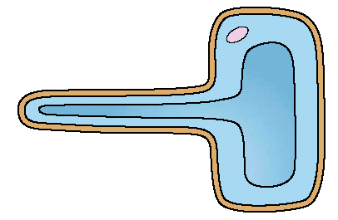
What do these cells have in common?

Slide 5
Sperm cell
Head contains enzymes & nucleus
Designed to Fertilise eggs.
Found in the Testes
Tail
A sperm is small and has a long tail that provides movement so it can swim and find an egg cell.
The head contains enzymes which allow it to digest into an egg cell and join with it.

Slide 6
Egg (Ovum) Cell
Cytoplasm containing yolk
Designed to be Fertilised.
Found in the Ovaries.
An egg cell is large and bulky.
Contains yolk which provides a large food store for the new cell being formed.
Layer of jelly
Nucleus

Slide 7
Palisade Cell
Designed for Photosynthesis
Found in the top of a leaf
Tall and has a large surface area to absorb water and minerals.
Packed with chloroplasts to help make plant food.
Nucleus
Chloroplasts

Slide 8
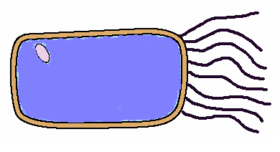
Ciliated Cell
Designed to stop Lung Damage
They line all the air passages in the lungs.
They have tiny hairs called cilia.
Hairs sweep mucus with trapped dust and bacteria back up the throat.
Nucleus
cilia

Slide 9
Root Hair Cell
Thin cell wall makes it easy for minerals to pass through.
Designed for absorbing.
Vacuole
thin cell wall
Cell membrane
Has a large surface which helps it to absorb water and minerals.
Found in a plant root.

Slide 10
Nerve Cell (neurone)
Nucleus
They are long
They have connections at each end
Can carry electrical signals
Their job is to carry nerve impulses to different parts of the body.

Slide 11
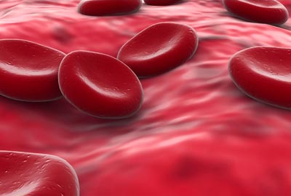
Red Blood Cell
Designed to carry oxygen
Found in blood.
Large surface area, for oxygen to pass through.
Contains haemoglobin, which joins with oxygen.
Has no nucleus

Slide 12
Copy and fill in the gaps:
Some cells have special jobs to do. They often have special shapes to help them do their job. We say that these cells are _________________ to do their jobs.
A group of the same type of cells, all working together, is called a _________________ .
A group of muscle cells all grouped together is called _________________ . Muscle cells help us to _________________ .
adapted move muscle tissue
adapted
tissue
muscle
move

